Slide 1


Slide 2
PREDICTING MISUSE OF STIMULANT MEDICATIONS BASED ON GEOMETRIC DEEP LEARNING
Hamid Razavi
M.S. in Data Science Masters, Data Science Department
Dr. Mengjia Xu
Dr. Hai Phan, Dr. Mengnan Du, Dr. Lijing Wang
12/02/2024

Slide 3
Abstract Overview
Objective: Predict stimulant misuse using graph-based deep learning techniques.
Methods: NSDUH data, GCN model.
Key Findings: GCN achieved highest accuracy (96.10%).
Notes:
Compared the results of the graph based model GCN vs 6 other ML models
Use data from the National Survey on Drug Use and Health (NSDUH)
It is the primary source of statistics on the use of alcohol, tobacco, prescription psychotherapeutic medicines (such as sedatives, painkillers, tranquilizers, and stimulants), and other substances (such as cocaine and marijuana) by individuals in that population who are 12 years of age or older
GCN outperformed other models

Slide 4

Problem Statement
Prescription stimulant misuse is a growing public health issue, especially among young adults.
High potential for addiction and severe health risks
Addresses a critical gap in understanding misuse patterns.
Utilizes Geometric Deep Learning to improve prevention strategies.
Notes:
The misuse of stimulant prescription medications, particularly among young adults, poses a significant public health concern. These medications, often used for conditions like ADHD, carry a high potential for abuse and dependency, as classified by the DEA as Schedule II substances. Misuse, defined as using the medication without a prescription or in ways not prescribed, can lead to severe health issues, such as cardiovascular events, addiction, and mental health problems. Additionally, misuse may contribute to the use of other illicit substances. Identifying patterns and factors associated with misuse is crucial for developing effective prevention strategies and reducing the associated health and social risks.

Slide 5
Motivations - 1
  Individual Level: Fewer health, dependency, and legal issues.
  Public Health: Better prevention, less system strain.
  Societal Impact: Less legal issues, data driven insights for policy making

Slide 6
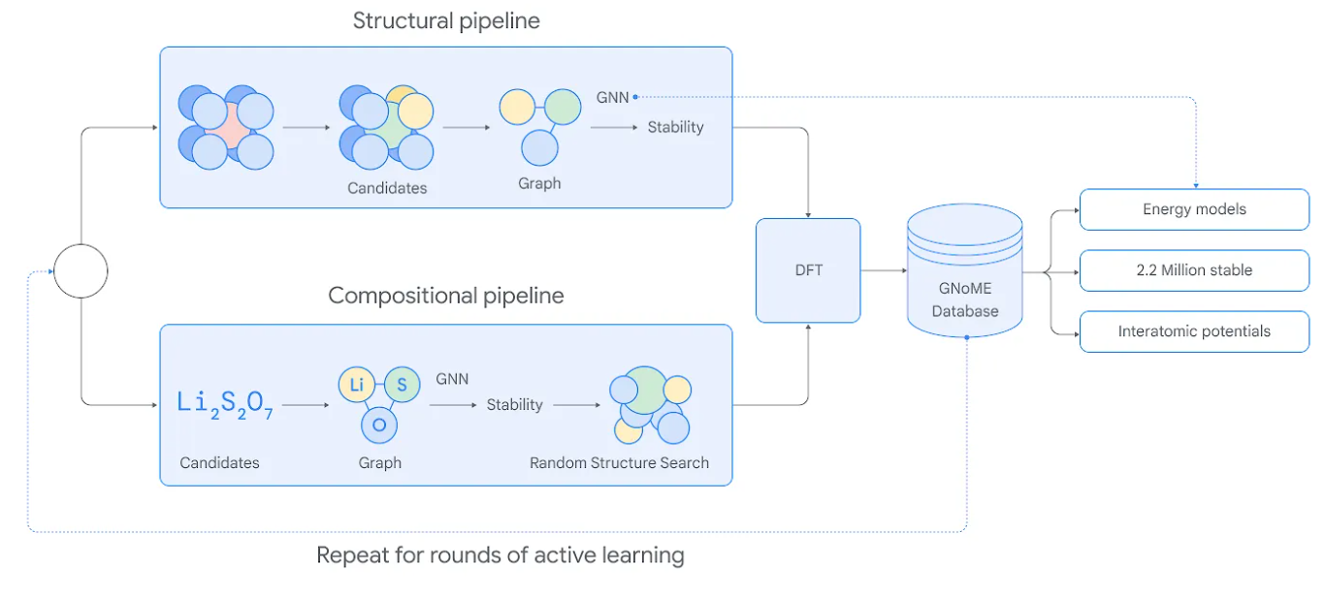
Motivations - 2
Personal Motives:
  ADHD
  Graph Networks for Material Discovery
https://deepmind.google/discover/blog/millions-of-new-materials-discovered-with-deep-learning/
Notes:
GNoME uses two pipelines to discover low-energy (stable) materials. The structural pipeline creates candidates with structures similar to known crystals, while the compositional pipeline follows a more randomized approach based on chemical formulas. The outputs of both pipelines are evaluated using established Density Functional Theory calculations and those results are added to the GNoME database, informing the next round of active learning.
Density functional theory (DFT) is a quantum-mechanical atomistic simulation method to compute a wide variety of properties of almost any kind of atomic system

Slide 7
Objectives
Predict Misuse
Analyze Patterns
Evaluate GCN
Benchmark Models
Aid Prevention
Notes:
Develop models to predict the likelihood of stimulant medication misuse using machine learning techniques.
Identify tendencies and contributing factors associated with misuse using advanced data analysis.
Assess the performance of a Graph Convolutional Network (GCN) in capturing complex relationships within survey data.
Compare the GCN's effectiveness against traditional machine learning models like SVM, MLP, and Random Forest.
Provide actionable insights to inform strategies for reducing stimulant misuse and its associated risks.

Slide 8
Major Hurdles
Dataset Issues
Model Debugging
Feature Selection
Computation Limits
Time Constraints
Notes:
Imbalanced dataset, Handling missing/inconsistent data and structuring it for GCN use.
Fixing tensor shape errors and ensuring fair model comparisons.
Managing redundant features to improve performance and efficiency.
Frequent kernel crashes resolved by premium Google Colab or using subsets of dataset, but run times remained long.
Managed full-time work, different time zones, and being overseas.

Slide 9
Methodologies Workflow
Data Collection
Preprocessing
Feature Engineering
Benchmarks Training and Evaluation
Build Graph for GCN
Data Preparation for the GCN
GCN Model Architecture
Model Training & Evaluation
GNN Explainer
Analyze Results & Draw Conclusions

Slide 10
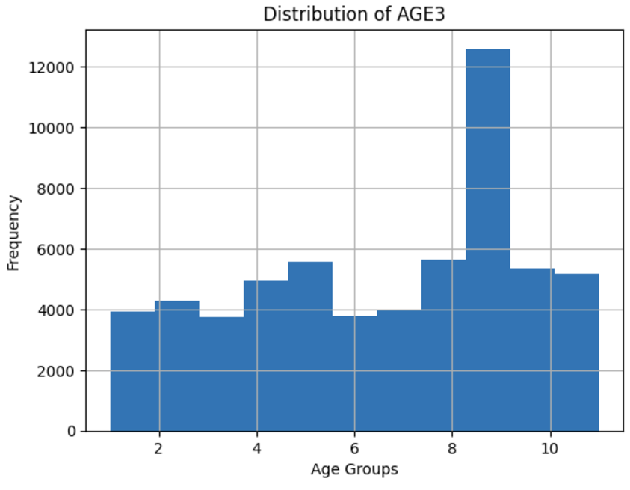
Data Collection
Dimension (59069, 2606)
Number of Features (59069, 204)
Train/Test Split
Cross Validation
Notes:
59069 individuals over the age of 12
Mostly Respondent is between 35 and 49 years oldwhich is category 9 of the survey question age
splited the dataset into training and testing subsets, with 80% of the data used for training the model and 20% reserved for evaluating its performance. The random_state=3 ensures the split is reproducible, providing consistent results across multiple runs.
Used the cross validation on models, Cross-validation splits the data into kkk folds (e.g., 3, 5, or 10) to train the model on k−1k-1k−1 folds and validate it on the remaining fold, rotating through all folds. This ensures the model is evaluated on different subsets of data, providing a robust measure of performance and reducing the risk of overfitting. Using 3, 5, or 10 folds balances computational cost and model evaluation accuracy, depending on the dataset size and complexity.

Slide 11
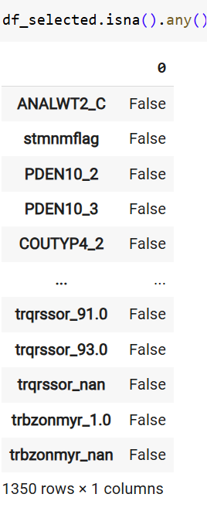
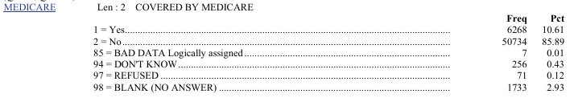
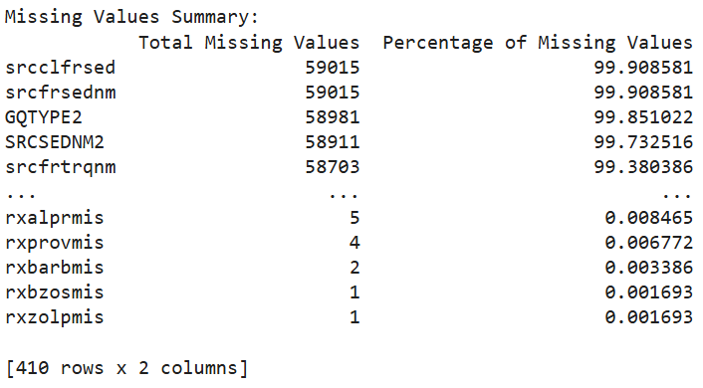
Data Preprocessing
1. Handling missing values.
2. Encoding categorical features.
3. Normalizing numerical data.
Notes:
Although there were considerable number of missing values in the entire dataset, there is no NaN in our selected features
Models like logistic regression, support vector machines (SVMs), and neural networks operate on numerical arrays. Categorical data needs to be converted into a format that preserves its meaning numerically.
One-hot encoding transforms categorical variables into binary columns (0s and 1s), where each unique category in a feature gets its own column. If a category is present in a row, its corresponding column is marked as 1, and all others are 0.
The cumulative expansion across all categorical features significantly increased the total number of variables, resulting in 1,350 variables.
used MinMaxScaler to normalize my data by scaling all numerical features to a range between 0 and 1. This ensured that all features contributed proportionally to the model and prevented larger values from dominating the learning process.

Slide 12
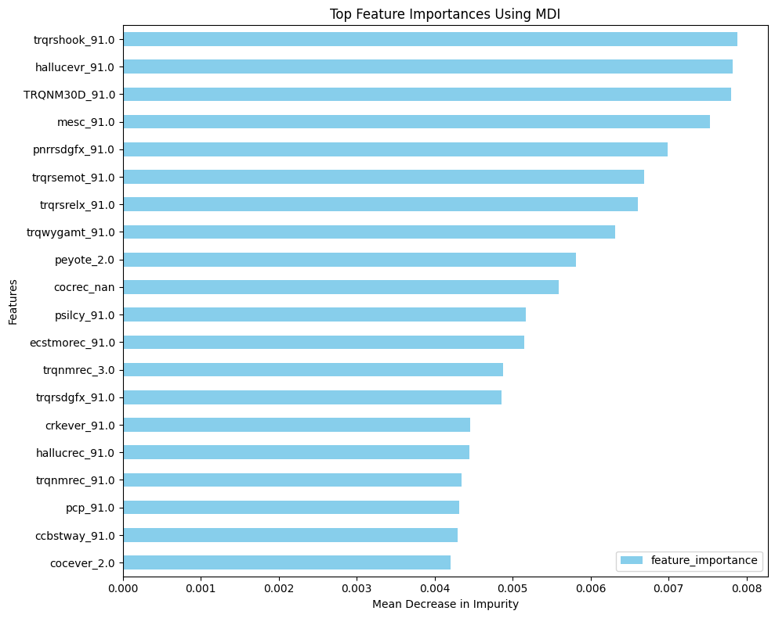
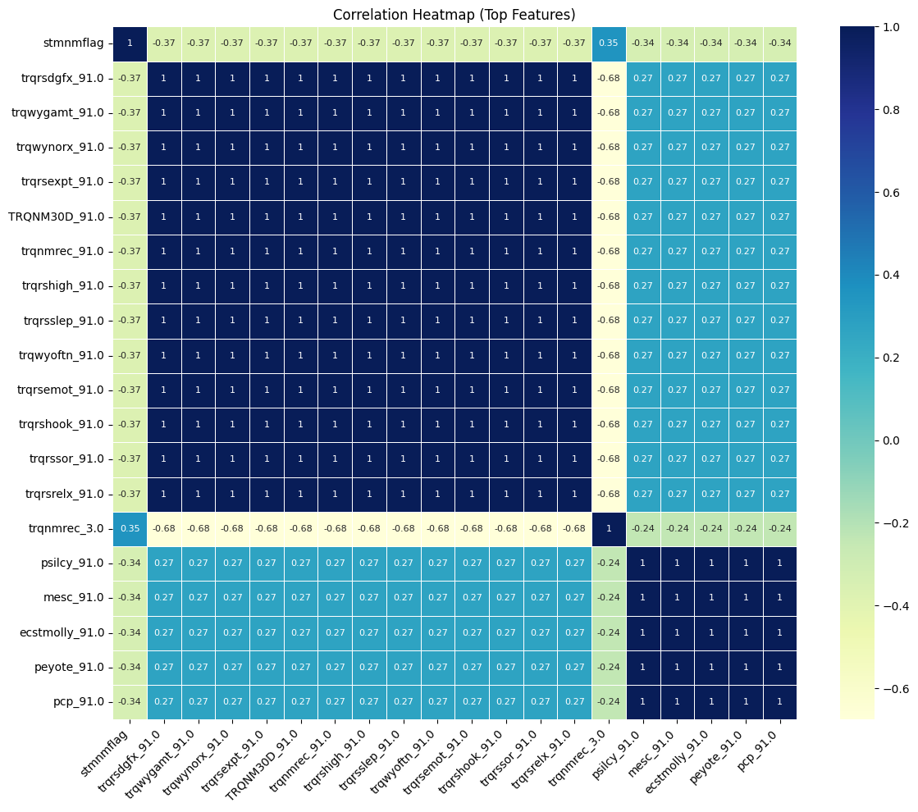
Feature Engineering
Key features: substance-use history, demographic data, behavioral indicators.
Techniques: Feature selection based on importance scores.
Notes:
Areas to improve: use the feature importance to extract the most important features.
Use heat map for the correlations among the top features, highlighting strong positive correlations (values near 1) among several variables, particularly those starting with "trqr" and related groups. There are also notable negative correlations (e.g., -0.37 and -0.68) between certain features, suggesting potential relationships or redundancies that could influence model performance.

Slide 13
Performance Metrics
Metrics used:
- Accuracy
- Precision
- Recall
- F1-score
Notes:
Accuracy: The ratio of correctly predicted instances (true positives + true negatives) to the total instances.
Precision: The proportion of true positives among all predicted positives (true positives / (true positives + false positives)).
Recall (Sensitivity): The proportion of true positives identified out of all actual positives (true positives / (true positives + false negatives)).
F1-Score: The harmonic mean of precision and recall, balancing the trade-off between them.

Slide 14
Logistic Regression
Binary Classification with Sigmoid Function
Balanced precision and recall, with an F1 score indicating high reliability.
Strong performance for generalization.
Metric | Test-Set (No CV) | 3-Fold CV | 5-Fold CV | 10-Fold CV
Accuracy | 0.9587 | 0.9602 ± 0.0025 | 0.9607 ± 0.0028 | 0.9604 ± 0.0031
Precision | 0.9512 | 0.9531 ± 0.0036 | 0.9537 ± 0.0038 | 0.9533 ± 0.0043
Recall | 0.9587 | 0.9602 ± 0.0025 | 0.9607 ± 0.0028 | 0.9604 ± 0.0031
F1 Score | 0.9517 | 0.9541 ± 0.0024 | 0.9546 ± 0.0032 | 0.9544 ± 0.0037
Notes:
the Logistic Regression model's steady metrics, alongside low variability across evaluations, underscore its dependability and appropriateness for the classification task, positioning it as a strong candidate for predictive modeling in this scenario.
Key Highlights:Predicts binary outcomes using a logistic (sigmoid) function.Features linear interpretability and uses Maximum Likelihood Estimation for optimization.Performance:Test Accuracy: 95.87%10-Fold CV Accuracy: 96.04 ± 0.0031Balanced precision and recall, with an F1 score indicating high reliability.Insights:Strong performance for generalization.High interpretability makes it ideal for understanding the influence of predictors.

Slide 15
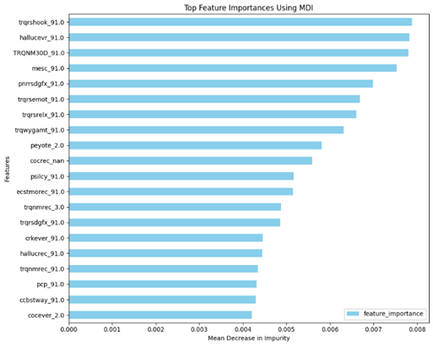
Random Forest
Feature importance revealed behavioral and demographic predictors as key.
Strong performance for generalization.
Useful for interpreting feature significance in stimulant misuse prediction.
Metric | Test-Set (No CV) | 3-Fold CV | 5-Fold CV | 10-Fold CV
Accuracy | 0.9571 | 0.9591 ± 0.0013 | 0.9592 ± 0.0019 | 0.9592 ± 0.0024
Precision | 0.9485 | 0.9508 ± 0.0022 | 0.9508 ± 0.0027 | 0.9510 ± 0.0038
Recall | 0.9571 | 0.9591 ± 0.0013 | 0.9592 ± 0.0019 | 0.9592 ± 0.0024
F1-Score | 0.9487 | 0.9511 ± 0.0010 | 0.9513 ± 0.0023 | 0.9515 ± 0.0030
Notes:
Despite its overall strength, the model may encounter difficulties in accurately predicting instances of stimulant misuse, potentially due to limitations in feature selection or unreported cases in the dataset. For example, although both accuracy and recall are high, precision indicates that there is still potential for improvement in recognizing true positive cases.

Slide 16
Gaussian Naïve Bayes
High precision and recall ensure balanced predictions
Strong performance for generalization
Quick to train, simple
Reliable for computational efficiency
Metric | Test-Set (No CV) | 3-Fold CV | 5-Fold CV | 10-Fold CV
Accuracy | 0.9080 | 0.9079 ± 0.0019 | 0.9079 ± 0.0020 | 0.9079 ± 0.0023
Precision | 0.9523 | 0.9522 ± 0.0009 | 0.9523 ± 0.0016 | 0.9523 ± 0.0019
Recall | 0.9080 | 0.9079 ± 0.0019 | 0.9079 ± 0.0020 | 0.9079 ± 0.0023
F1 Score | 0.9250 | 0.9250 ± 0.0015 | 0.9250 ± 0.0014 | 0.9250 ± 0.0017
Notes:
Probabilistic classifier based on Bayes' theorem with Gaussian distribution assumption.
Assumes conditional independence of features within each class.

Slide 17
K-Nearest Neighbors
Euclidean distance metric with k=5
High recall but lower precision indicates false positives.
Balanced precision and recall increasing reliability
Metric | Test-Set (No CV) | 3-Fold CV | 5-Fold CV | 10-Fold CV
Accuracy | 0.9200 | 0.9550 ± 0.0170 | 0.9512 ± 0.0214 | 0.9525 ± 0.0278
Precision | 0.8843 | 0.9541 ± 0.0164 | 0.9323 ± 0.0508 | 0.9299 ± 0.0595
Recall | 0.9200 | 0.9550 ± 0.0170 | 0.9512 ± 0.0214 | 0.9525 ± 0.0278
F1 | 0.8946 | 0.9429 ± 0.0297 | 0.9390 ± 0.0350 | 0.9377 ± 0.0430
Notes:
k-NN algorithm showcases impressive predictive capability for stimulant misuse, particularly regarding its accuracy and recall scores. However, the discrepancies seen in precision and F1 scores imply that further enhancements, such as fine-tuning the k value, tackling possible class imbalances, or engaging in feature engineering, could bolster the overall robustness of the model.

Slide 18
Support Vector Machine
Minimizes false positives
Robust CV results
Balanced precision and recall increases reliability
Metric | Test-Set (No CV) | 3-Fold CV | 5-Fold CV | 10-Fold CV
Accuracy | 0.9150 | 0.9475 ± 0.0030 | 0.9400 ± 0.0064 | 0.9437 ± 0.0170
Precision | 0.9441 | 0.9460 ± 0.0051 | 0.9415 ± 0.0051 | 0.9469 ± 0.0190
Recall | 0.9150 | 0.9475 ± 0.0030 | 0.9400 ± 0.0064 | 0.9437 ± 0.0170
F1 Score | 0.9284 | 0.9467 ± 0.0040 | 0.9407 ± 0.0054 | 0.9431 ± 0.0175
Notes:
SVM model shows outstanding performance across both the test set and the cross-validation folds. The high precision and recall indicate that the model effectively balances the minimization of false positives and false negatives, making it suitable for applications where this balance is vital. The consistency of the metrics across various cross-validation methods further underscores the model’s reliability and robustness.

Slide 19
Multi Layer Perceptron
Captures complex patterns
Requires significant computational resources.
Metric | Test-Set (No CV) | 3-Fold CV | 5-Fold CV | 10-Fold CV
Accuracy | 0.9450 | 0.9540 ± 0.0013 | 0.9580 ± 0.0093 | 0.9580 ± 0.0125
Precision | 0.9233 | 0.9454 ± 0.0045 | 0.9543 ± 0.0128 | 0.9528 ± 0.0212
Recall | 0.9450 | 0.9540 ± 0.0013 | 0.9580 ± 0.0093 | 0.9580 ± 0.0125
F1 | 0.9307 | 0.9473 ± 0.0056 | 0.9514 ± 0.0139 | 0.9521 ± 0.0173
Notes:
MLP model demonstrates outstanding performance in predicting stimulant misuse, achieving high accuracy and recall in all assessments. For further enhancement, efforts could target increasing precision by minimizing false positives through feature engineering or hyperparameter optimization. The model's strong generalization on a limited dataset emphasizes its robustness, positioning it as a valuable tool for stimulant misuse prediction initiatives.

Slide 20
Conclusions
Build Graph for GCN
Data Preparation for the GCN
GCN Model Architecture
Model Training & Evaluation
GNN Explainer

Slide 21
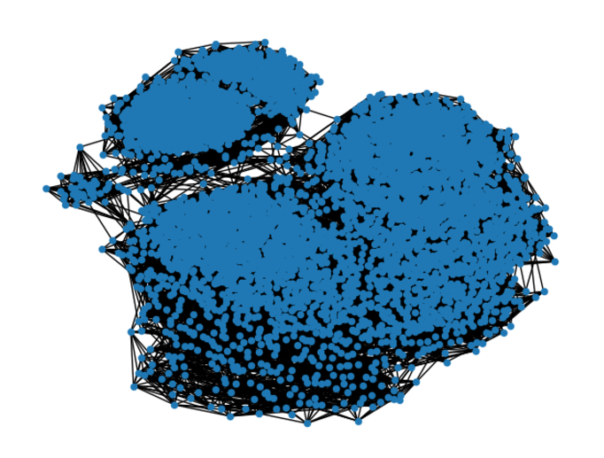
Build Graph for GCN
Create Adjacency Matrix
Convert to Graph
Prepare for PyTorch Geometric
Handle Undirected Graphs
Notes:
Create Adjacency Matrix:
A weighted K-Nearest Neighbors (KNN) graph is generated using kneighbors_graph, with k=11 to connect each node to its 11 nearest neighbors based on distance.
The adjacency matrix A represents these connections, where non-zero entries denote the distances between connected nodes.
Convert to Graph:
The sparse adjacency matrix is converted to a NetworkX graph G, making it easier to inspect edges and their weights.
Prepare for PyTorch Geometric:
The NetworkX graph is converted into a PyTorch Geometric Data object.
Edge weights (representing distances) are assigned to the data.edge_weight attribute for use in weighted graph operations.
Handle Undirected Graphs:
Since the graph is undirected, edge weights are duplicated to match the bidirectional representation of edge_index in PyTorch Geometric.

Slide 22
Data Preparation for the GCN
Feature and Label Conversion
Transuductive model
Train-Test split
Graph data integration
Notes:
Data Splitting:
You split the data into training and test sets, but the adjacency matrix (graph structure) appears to remain intact and is used for both training and testing. In transductive learning, the model has access to the entire graph, including nodes that are part of the test set, although it doesn't use their labels during training.
Feature Assignment:
The node features (data.x) and the adjacency matrix are shared across the entire graph during model training and evaluation. This is typical of transductive GCNs, where the model leverages information from both labeled (training) and unlabeled (test) nodes via their connections in the graph.
Graph Context:
If the graph structure (nodes and edges) remains constant throughout the process and the model uses the relationships between training and test nodes, it fits the transductive paradigm.
Feature and Label Conversion:
The node features (X_less_rows) and labels (y_less_rows) are converted into PyTorch tensors.
Features use FloatTensor, and labels use LongTensor for compatibility with the GCN.
Train-Test Split:
The data is split into training and testing sets using train_test_split with an 80/20 ratio.
Graph Data Integration:
The feature matrix (data.x), labels (data.y), and edge weights (data.edge_weight) are all stored in the PyTorch Geometric Data object.

Slide 23
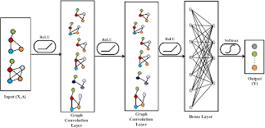
GCN Model Architecture
Layers:
  Layer 1
  Activation
  Dropout
  Layer 2
  Softmax
Output
Notes:
Layers:
Layer 1: A GCNConv layer transforms the input features using the graph structure and edge weights, producing a hidden representation.
Activation: A ReLU activation function introduces non-linearity.
Dropout: Dropout regularization prevents overfitting.
Layer 2: Another GCNConv layer maps the hidden representation to the output space (number of classes).
Output:
The final output applies log_softmax, providing class probabilities for each node.

Slide 24
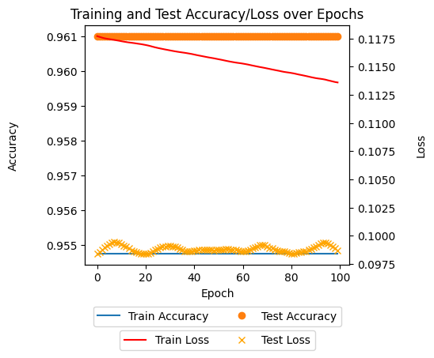
Model Training & Evaluation
Training
Evaluation
Notes:
Training:
The model uses a cross-entropy loss function to minimize classification errors.
An Adam optimizer updates the model parameters based on gradients computed during backpropagation.
Evaluation:
Training and testing accuracies are evaluated using the model's predictions on their respective masks.
Accuracy is computed using metrics from scikit-learn.
Iterative Optimization:
For 100 epochs, the model trains by minimizing loss on the training set and evaluates performance on both training and testing sets.
Performance Tracking:
Train/test accuracies and loss values are recorded for analysis.
The GCN model achieved strong generalization, with training accuracy of 95.47% and test accuracy of 96.10%, indicating reliable predictions without overfitting.Training loss declined from 0.1177 to 0.1136, while test loss settled at 0.0987, highlighting precise predictions and stability.The narrow accuracy margin between training and testing and the early performance plateau suggest optimal convergence and potential for early stopping.Future improvements include feature importance analysis, regularization strategies, and hyperparameter optimization to enhance robustness and accuracy.

Slide 25
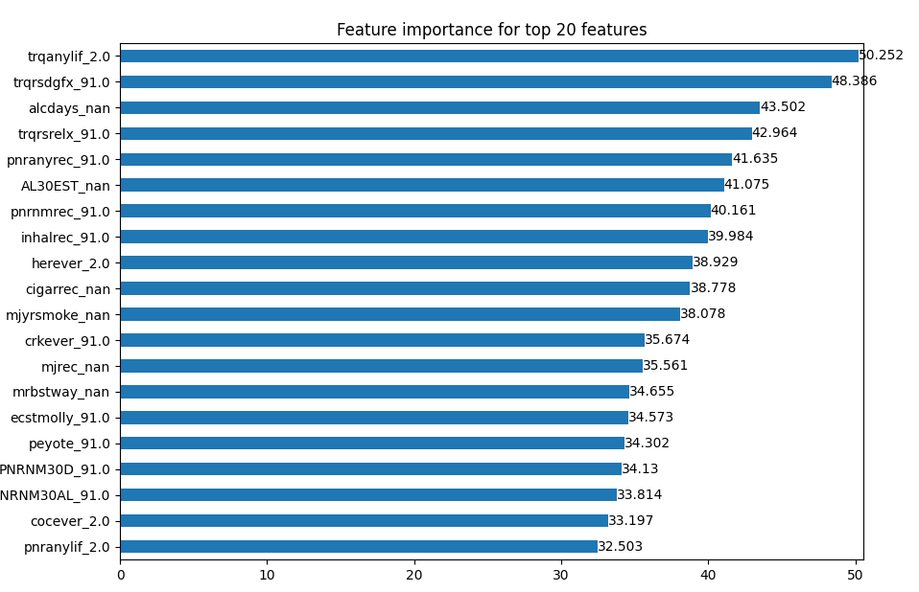
GNN Explainer – Feature Importance
Feature | Description | Importance Score
trqanylif | Ever used any prescription tranquilizer | 50.252
alcdays | Main reason for using tranquilizers | 48.386
alcdays | The number of days alcohol consumed in the past 30 days. | 43.502
trqrsrelx | Tranquilizers were used to relax or relieve tension. | 42.964
pnranyrec | When for most recent pain reliever used. | 41.635
AL30EST | The number of days had one or more drinks. | 41.075
pnrnrec | Recent nonmedical use of pain relievers. | 40.161
inhalrec | Whether inhalants were recently used. | 39.984
herever | If heroin has ever been used.
38.929
cigarrec | Time since last smoked Cigar. | 38.778
mjyrsmoke | Did you smoke marijuana within last year. | 38.078
crkever | Ever used crack. | 35.674
mjrec | When last smoked marijuana. | 35.561
mrbstway | Most recent method marijuana was used. | 34.655
ecstmolly | Ever used MDMA/ecstasy | 34.573
peyote | Ever used peyote (is a hallucinogen) | 34.302
PNRNM30D | Pain reliever nonmedical use in the past 30 days | 34.130
NRNM30AL | Nonmedical alcohol use in the past 30 days. | 33.814
cocever | Indicates if cocaine was ever used. | 33.197
pnranylif | Indicates lifetime use of pain relievers.
32.503
Notes:
The top 20 features impacting the model's prediction for node 10 were visualized, with importance scores ranked by GNNExplainer.The most significant feature, "trqanylif_2.0," scored 50.252, followed by "trqrsgdfx_91.0" (48.386) and "alcdays_nan" (43.502), showing varying levels of influence on predictions.Features include binary attributes (e.g., "trqanylif_2.0") and indicators for missing data (e.g., "alcdays_nan"), suggesting that absence of data can also hold predictive value.Behavioral and demographic features, such as "trqanylif_2.0" and "pnrnayrec_91.0," are tied to stimulant misuse or related risk factors, making them critical for model interpretation.These insights validate the model’s predictions, emphasizing the importance of behavioral, demographic, and survey-related features in assessing individual risk levels for stimulant misuse.

Slide 26
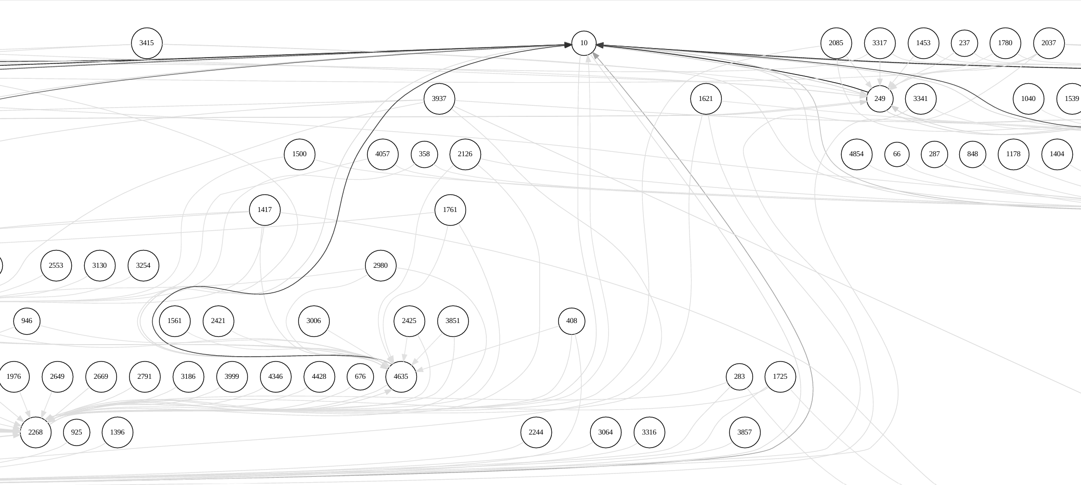
GNN Explainer - Subgraph Visualization
Notes:
The subgraph visualization, generated by the GNNExplainer for node_index = 10, highlights the most influential nodes and edges impacting the model's prediction for this specific node. It simplifies the larger graph, emphasizing only the critical relationships and features that contribute significantly to the prediction, with edge importance determined by calculated scores. In the context of predicting stimulant misuse, the subgraph reveals key factors such as social connections, demographic traits, or behavioral patterns that influence risk evaluation. This approach provides actionable insights by showcasing the model's decision-making process in an interpretable format, making it especially useful for personalized risk assessments and targeted interventions.
4o

Slide 27
Conclusion
GCN’s Top Performance
Insights and Implications
Rank | Model | Test-Set Accuracy | Training Accuracy
1 | GCN | 0.9610 | 0.9547
2 | Logistic Regression | 0.9587 | 0.9604
3 | Random Forest | 0.9571 | 0.9592
4 | MLP | 0.9450 | 0.9567
5 | KNN | 0.9200 | 0.9529
6 | SVM | 0.9150 | 0.9437
7 | Gaussian NB | 0.9080 | 0.9079
Notes:
GCN's Superior Performance: The GCN achieved the highest test accuracy (96.10%) and training accuracy (95.47%), showcasing its ability to model complex relationships in graph-structured data, making it ideal for predicting stimulant misuse.
Insights and Implications: The study highlights the value of graph-based approaches like GCN in understanding behavioral and demographic factors, enabling targeted interventions in public health. Future work could explore hybrid models, enhanced feature engineering, and additional data to further refine predictions.
This thesis explores the use of Graph Convolutional Networks (GCNs) to predict stimulant prescription medication misuse using data from the National Survey on Drug Use and Health (NSDUH). By modeling individuals as nodes and their relationships as edges, GCNs effectively capture complex interdependencies and relational patterns within the dataset, achieving the highest performance with a test accuracy of 96.10% and training accuracy of 95.47%. This demonstrates GCN’s ability to uncover intricate connections that traditional models might miss, making it well-suited for tasks where contextual and relational factors are critical. Conventional models like Random Forest and Logistic Regression also performed reliably, with test accuracies of 95.71% and 95.87%, respectively, while simpler models such as Gaussian Naive Bayes and k-Nearest Neighbors achieved satisfactory results, albeit less competitive. Feature importance analysis identified significant predictors like "trqanylif" (tranquilizer usage) and "trqrsgdfx" (reason for usage), highlighting the relevance of behavioral and demographic factors in predicting misuse. The study demonstrates the practical implications of machine learning in public health by showing how graph-based approaches like GCN can provide actionable insights into individual risk factors, enabling targeted interventions. Overall, this research emphasizes the importance of selecting models aligned with the data’s structure, with GCNs standing out as a robust tool for relational tasks. Future work could focus on enhancing feature engineering, integrating hybrid models, and incorporating additional contextual data to further improve predictions and interpretability.

Slide 28
Future Research
Medication Categories
Target-Specific Focus
Alternative Graph Construction
Feature Optimization
Regularization
Hyperparameter Tuning
Notes:
Medication Categories: Adapt the GCN model to predict misuse for painkillers, sedatives, and tranquilizers by customizing features and graph structures.Target-Specific Focus: Refine the model for specific drugs like Adderall by incorporating relevant factors in the graph.Alternative Graph Construction: Explore methods like cosine similarity to improve edge and weight representation in the graph.Feature Optimization: Analyze feature importance to reduce redundancy and add domain-specific features for better predictions.Regularization: Implement techniques like dropout or L2 regularization to ensure robustness in complex datasets.Hyperparameter Tuning: Optimize learning rates, GCN layers, and convolution methods to enhance predictive performance.

Slide 29
Acknowledgements
Advisor: Dr. Mengjia Xu.
Committee: Dr. Hai Phan, Dr. Mengnan Du, Dr. Lijing Wang.
Personal support: Family, Sahar.

Slide 30
Questions?
Thank you!

